Slide 1
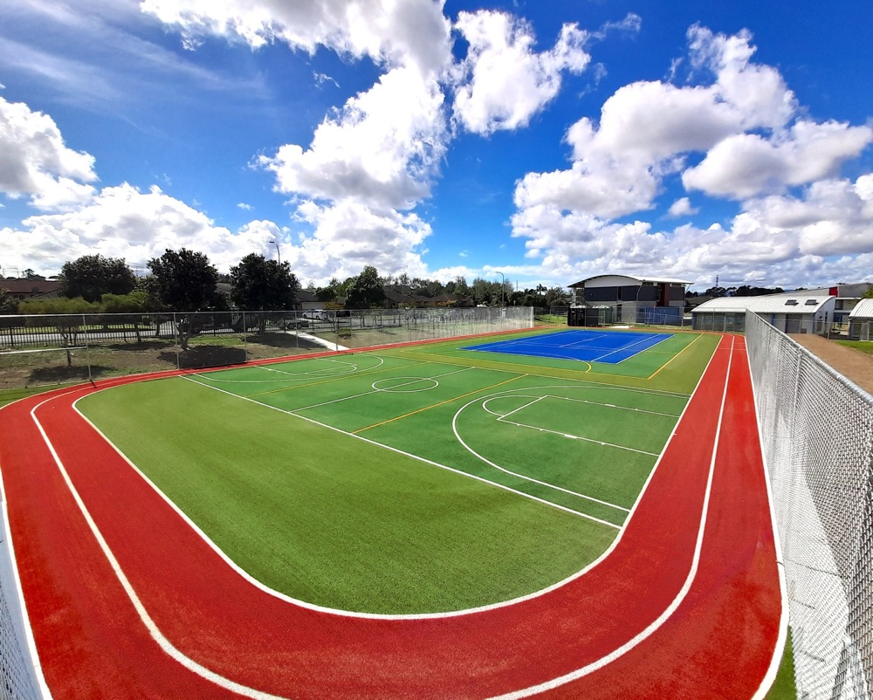
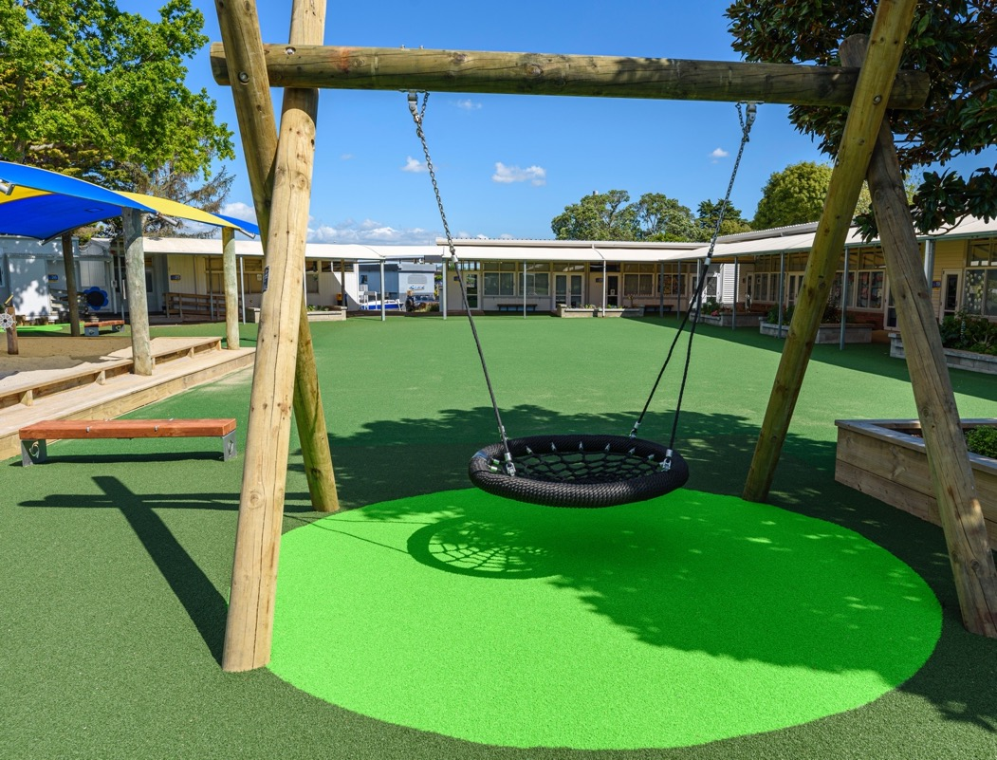

Teamturf
Proudly associated with NZCEO and APIS

Slide 2
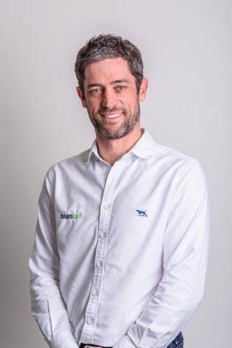
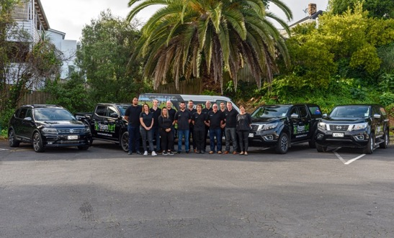


About us
Teamturf was established in 2006 , 16 years in business.
Founded by Phil Lewis and John Curtis who have been In the turf industry for 20/27 years respectively
Offers a large and varied product range sourced from reliable and reputable companies from Australia, Switzerland and Holland
Established agent network covering most of New Zealand

Slide 3
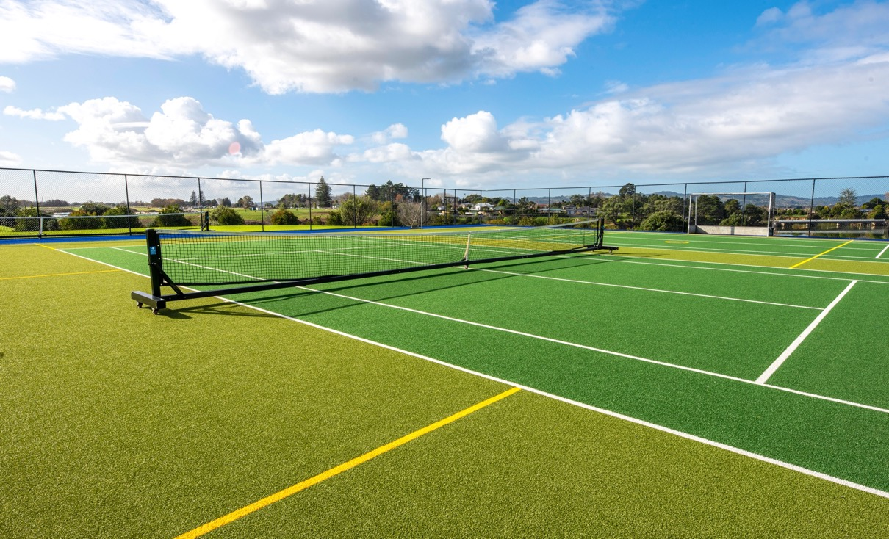
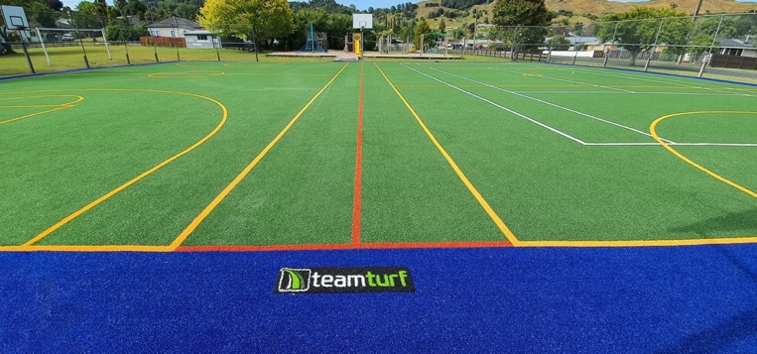
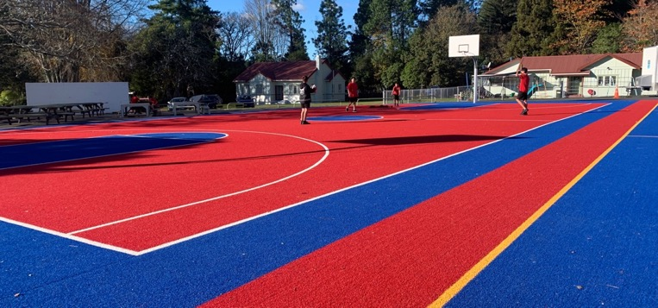
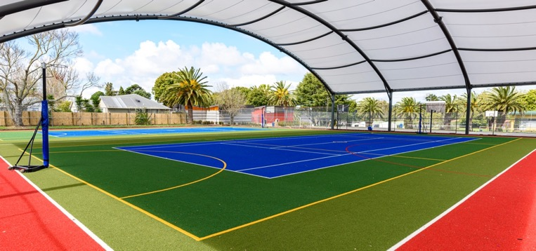

Multi-use courts
Existing concrete or asphalt
New build - concrete or metal
Limitless variation of line markings
Multiple colour choices
Attractive, low maintenance, all weather

Slide 4
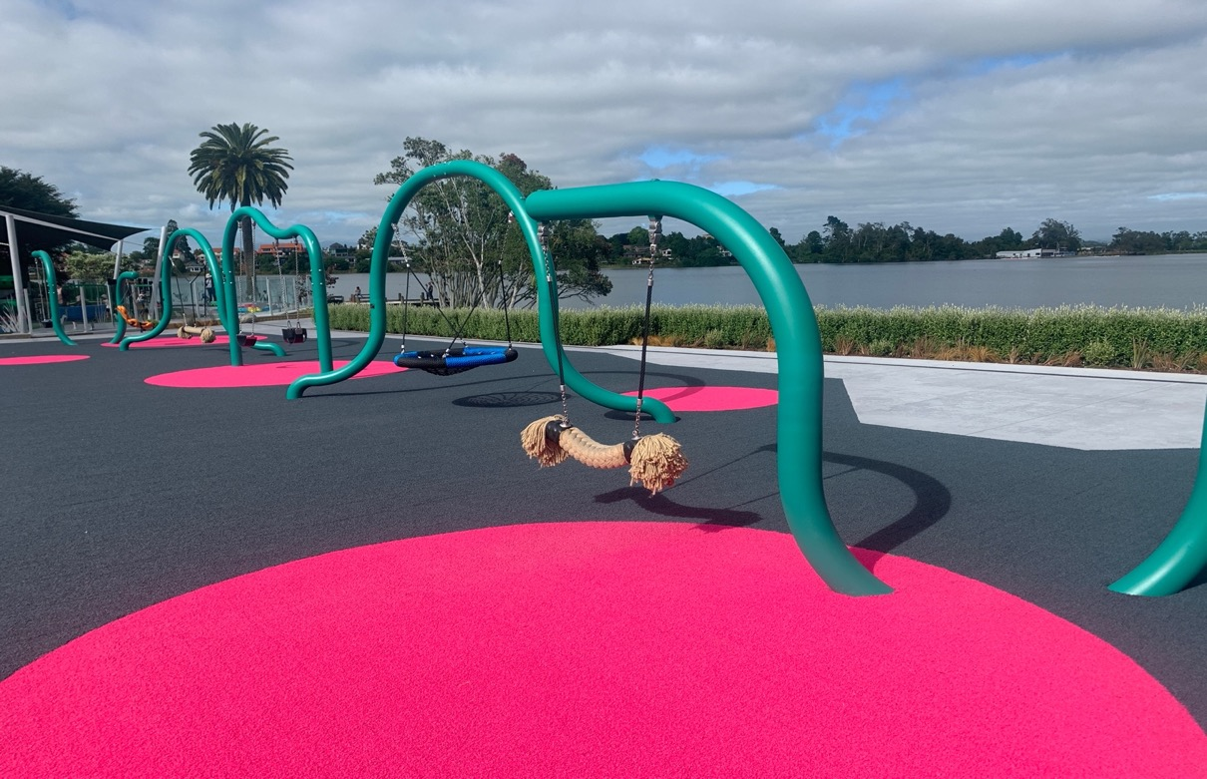
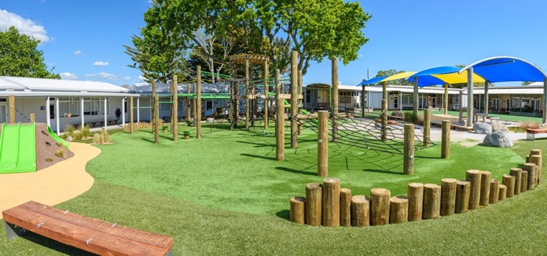
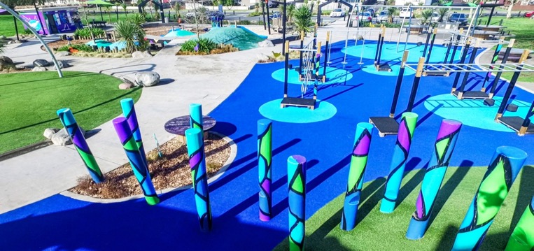
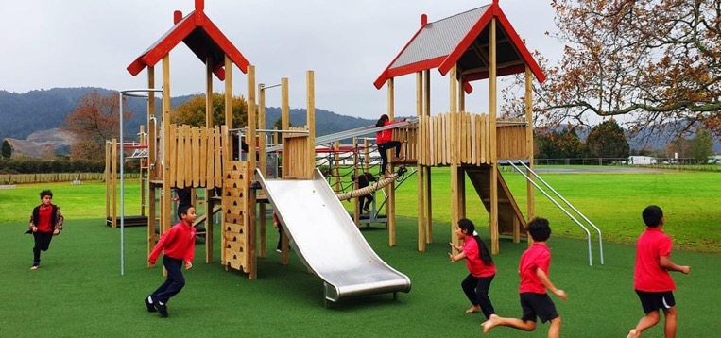

Playgrounds
Existing playgrounds – replace bark, tiles, matting
New builds working alongside playground installers
Shockpad to meet fall heights up to 3m
Natural looking grass or bright colourful designs

Slide 5
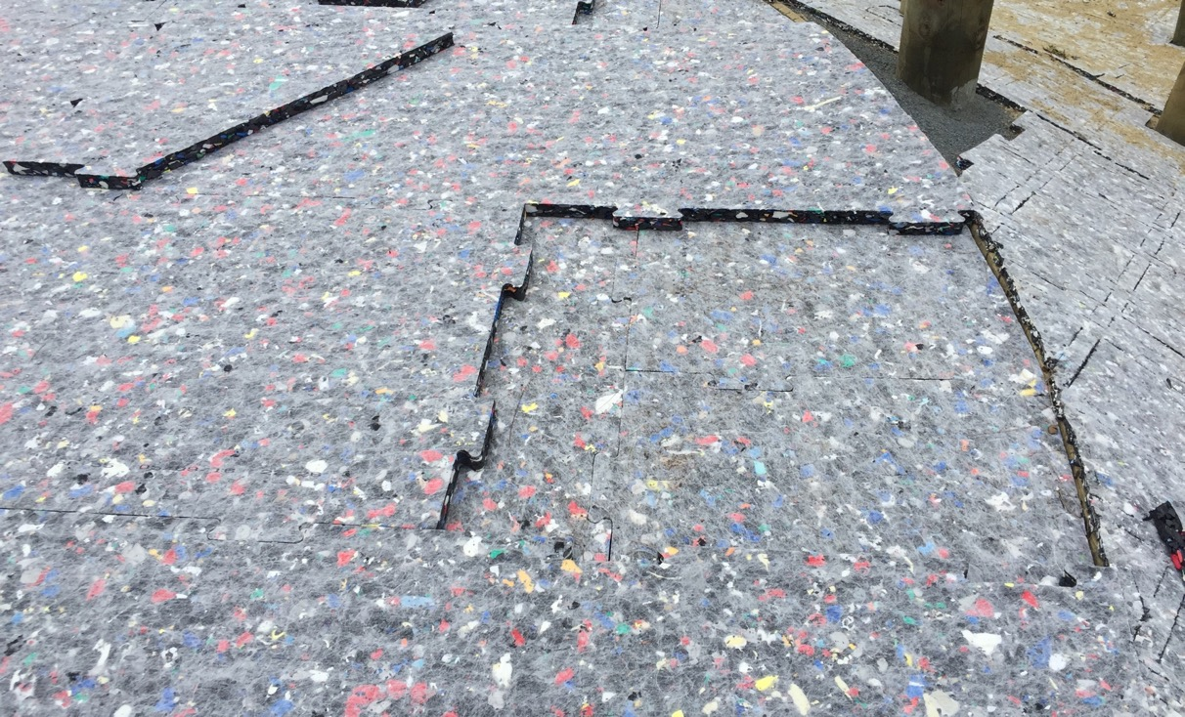
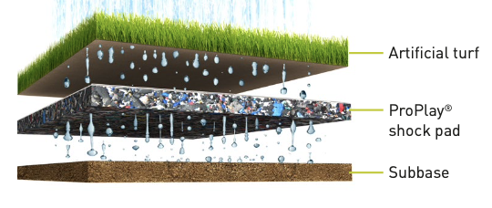
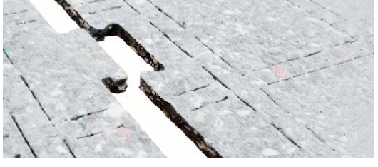

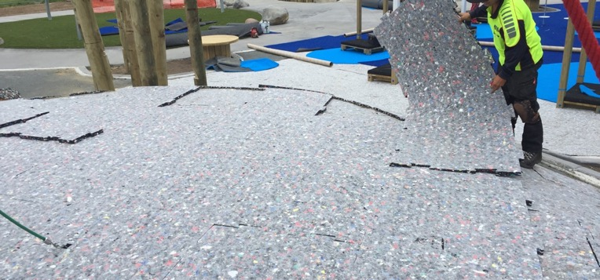

Proplay Pad
25 year guarantee
Certified to fall heights up to 3m
Interlocking system
Recycled/enviro friendly

Slide 6
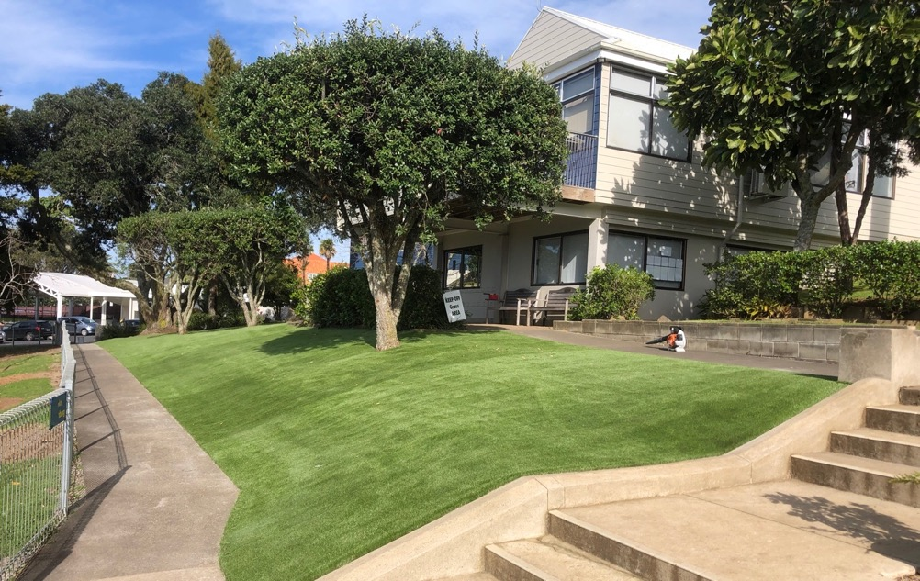
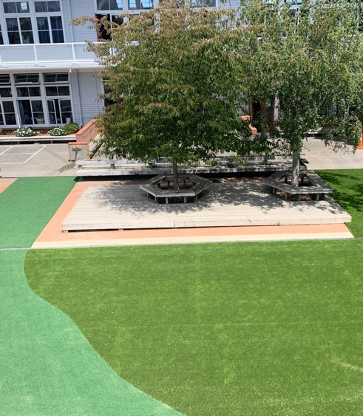
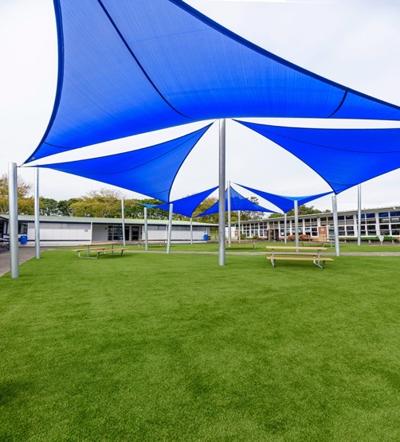
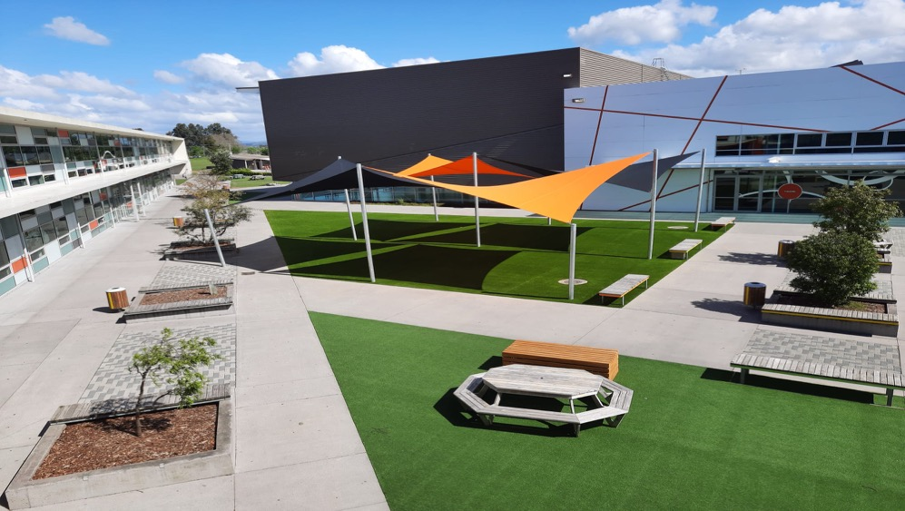

School landscaping
High use or shady areas where difficult to grow grass
Base preparation, free draining
Can go over existing concrete, asphalt or paving

Slide 7
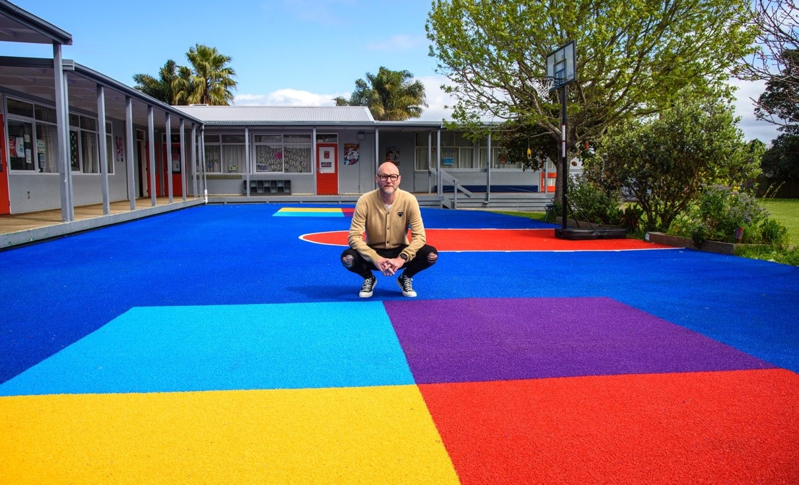
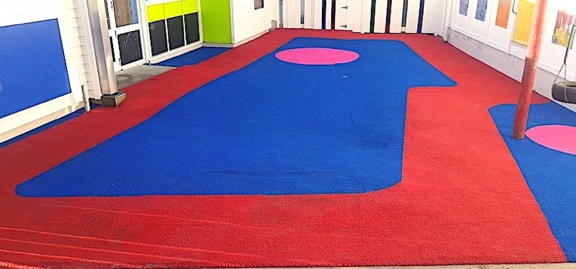
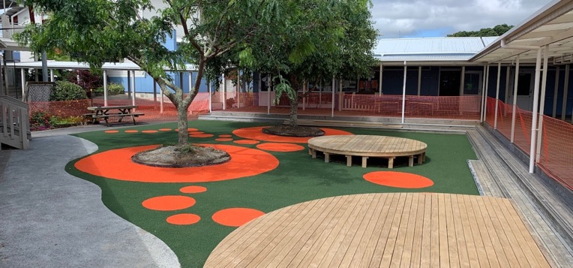
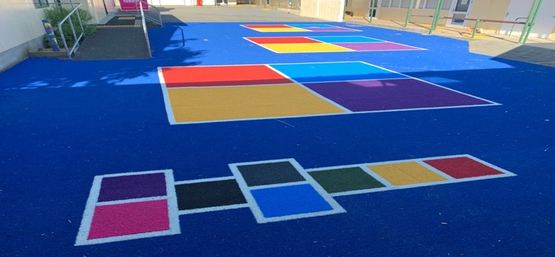
Courtyards
Utilise/maximise space
Transform old concrete/asphalt/pavers
Add colour, fun, games

Slide 8
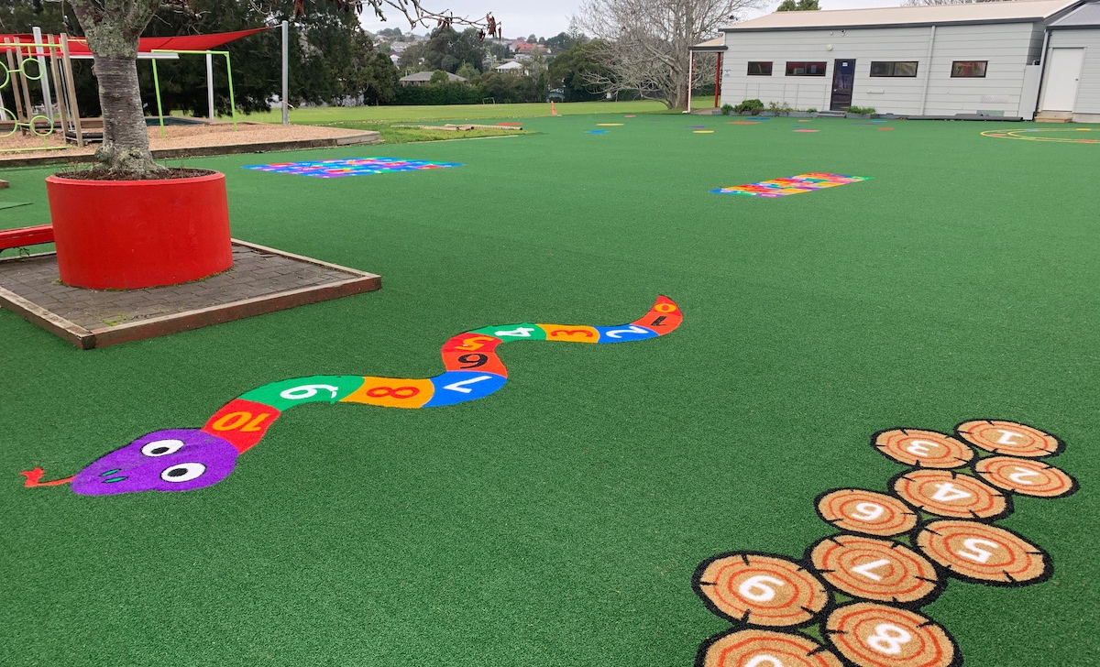
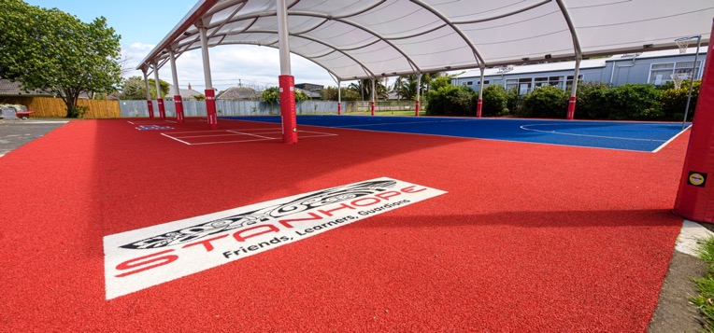
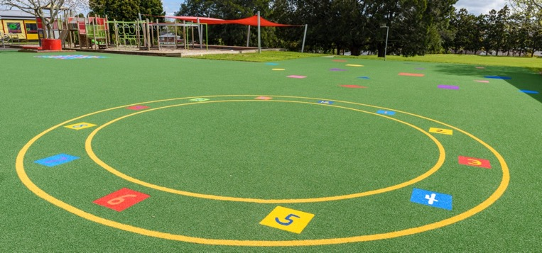
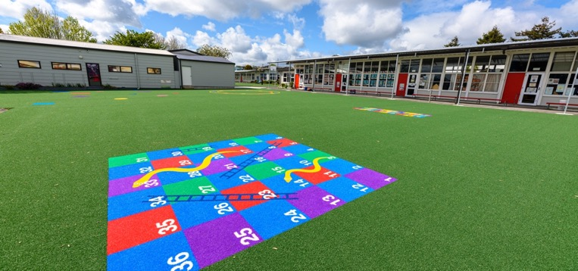
Signgrass
Large catalogue of pre-made fun items
Interactive games
Decorative pieces
School logos

Slide 9
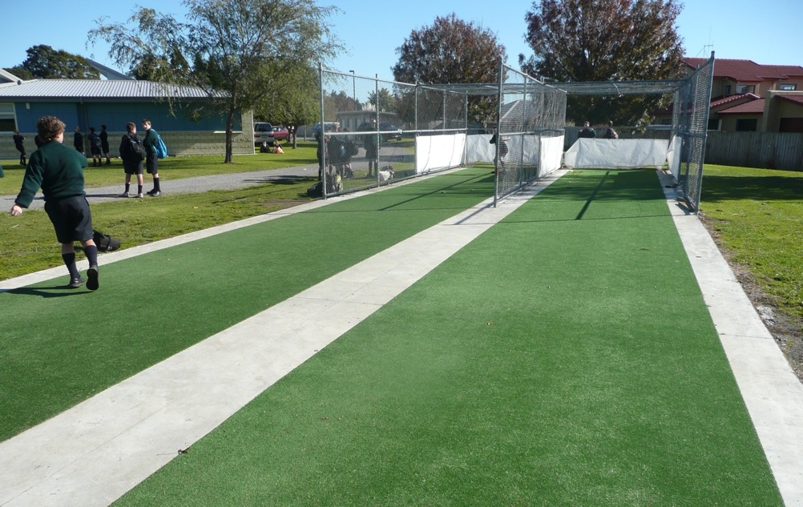
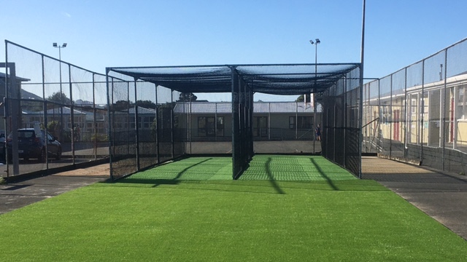
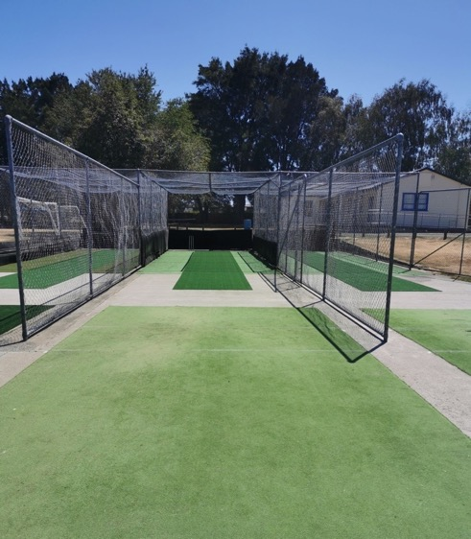
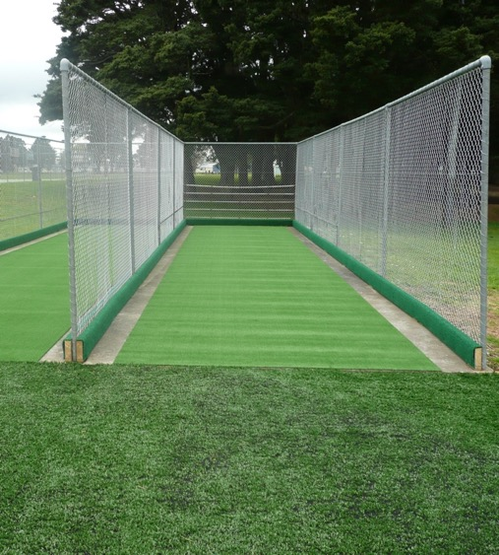

Cricket wickets
Pitches or Practice Nets
Turn-key: concrete pad, turf, nets, run-up
Galvanised mesh or soft nylon netting

Slide 10
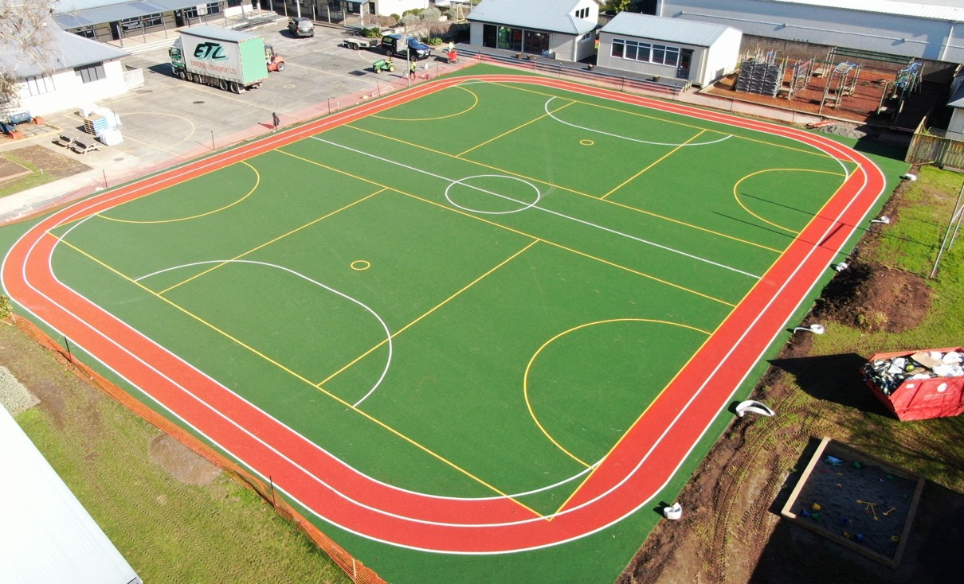
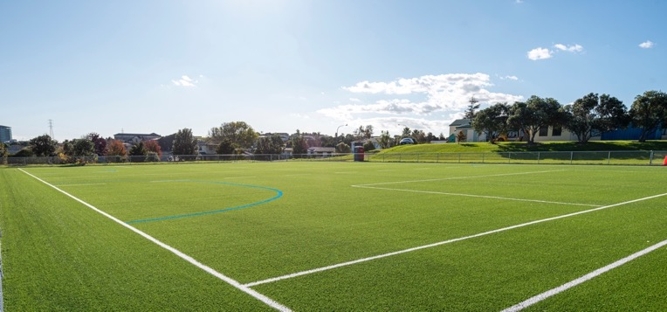
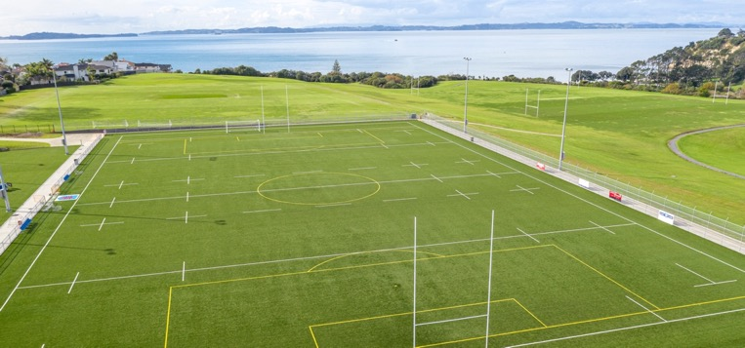
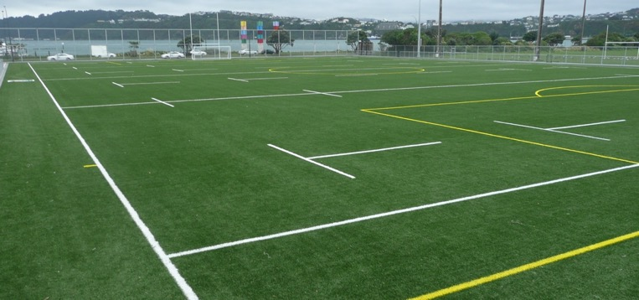

School Fields
500m² to 8,000m² plus!
Products for hockey, football, rugby and more
Get maximum usage of fields
Offer civil, turf, fencing and lighting options

Slide 11
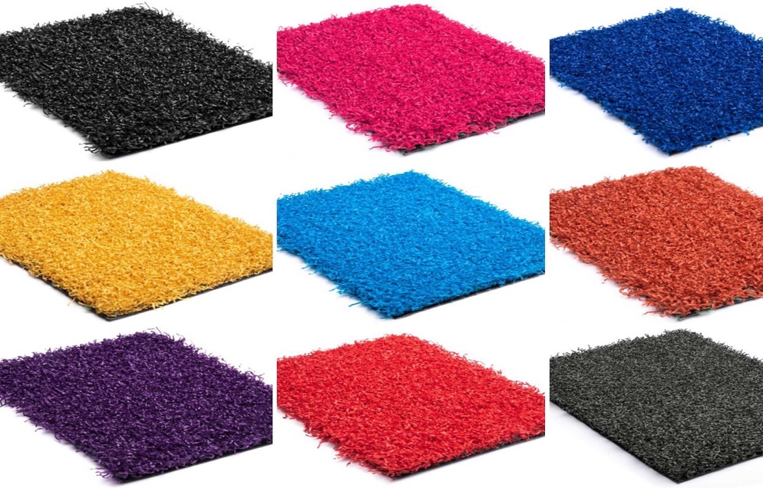
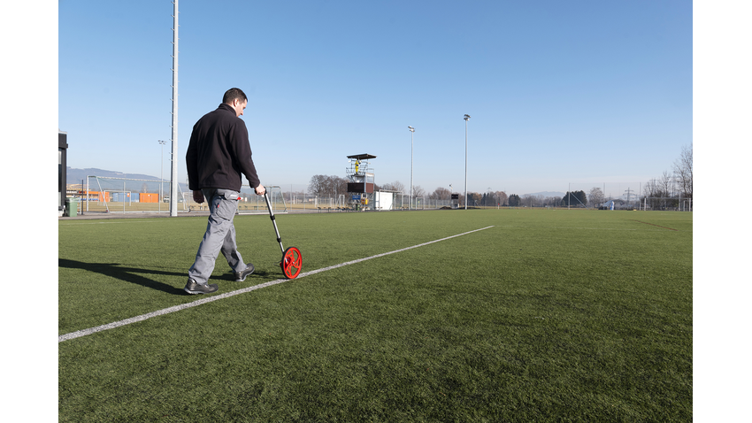
Next steps
Arrange a site visit
Discuss design
Turf samples
Measure, quote & CAD drawing

Slide 12
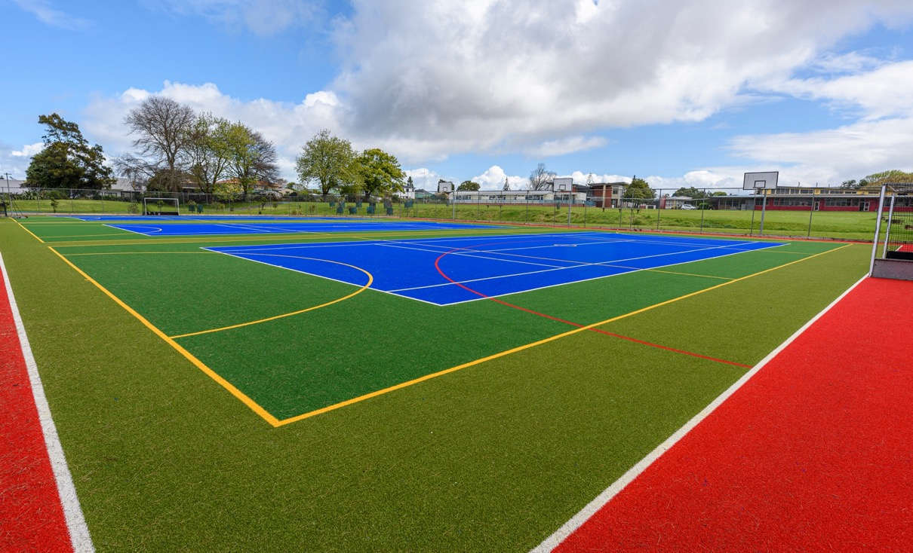
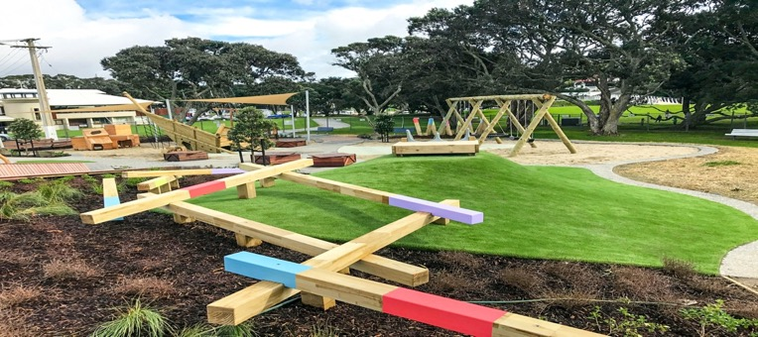
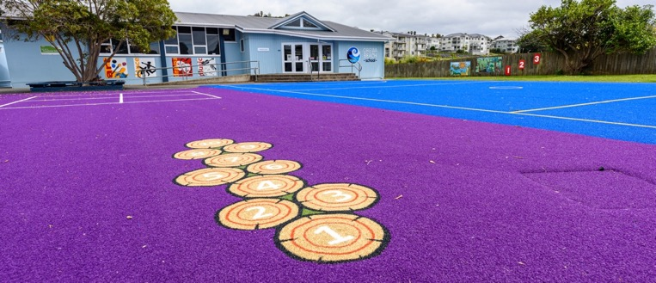
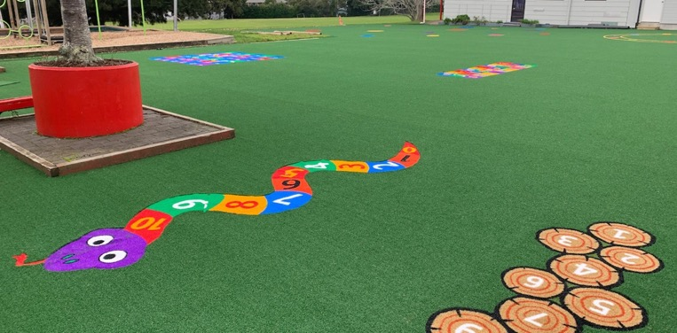

Thank you
Question time

